Slide 1
Main Types of Data Visualizations

Slide 2
Thanks to:
Kari Lock Morgan, Penn State University
For several* of these examples

Slide 3
Histograms (and Density Plots)

Slide 4
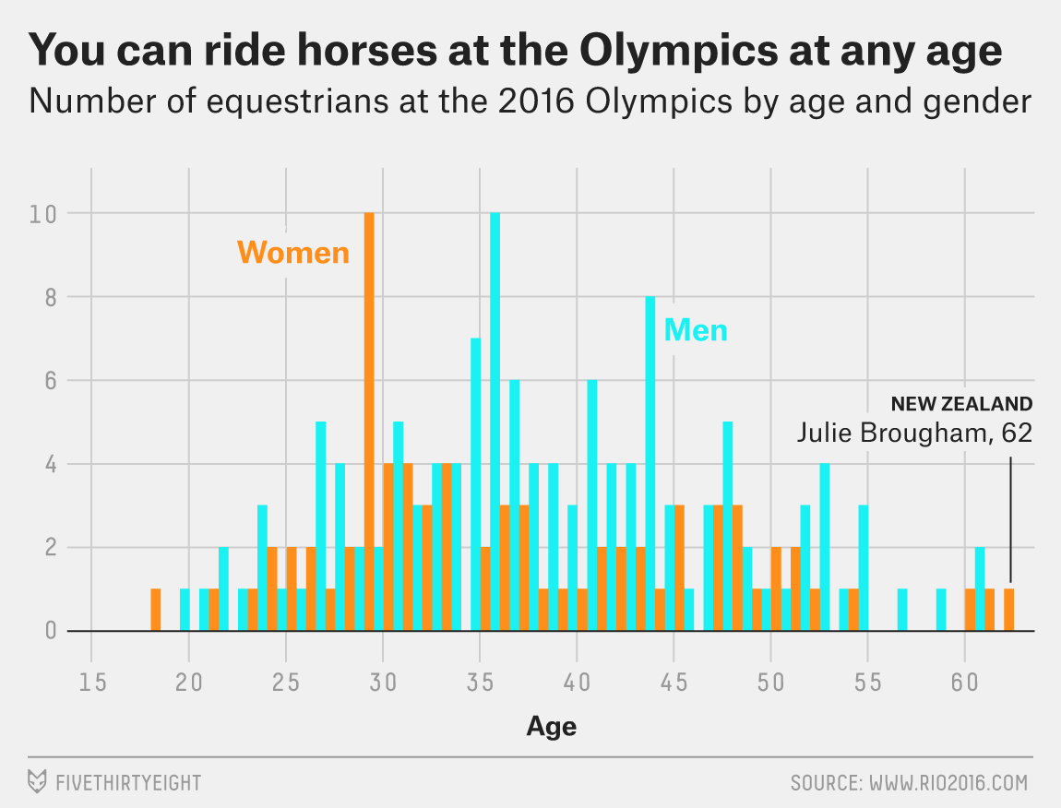

Slide 5
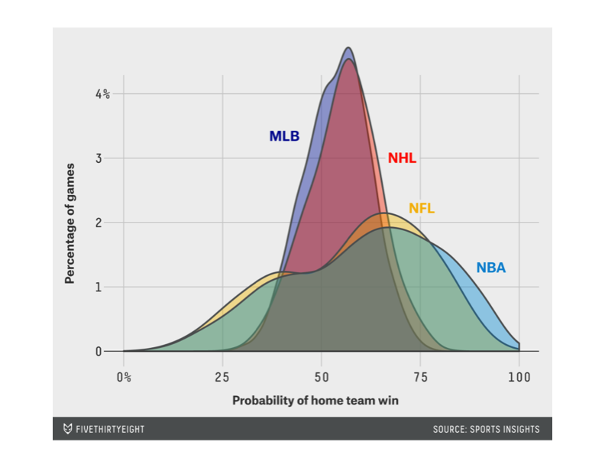
Chance of winning at home

Slide 6
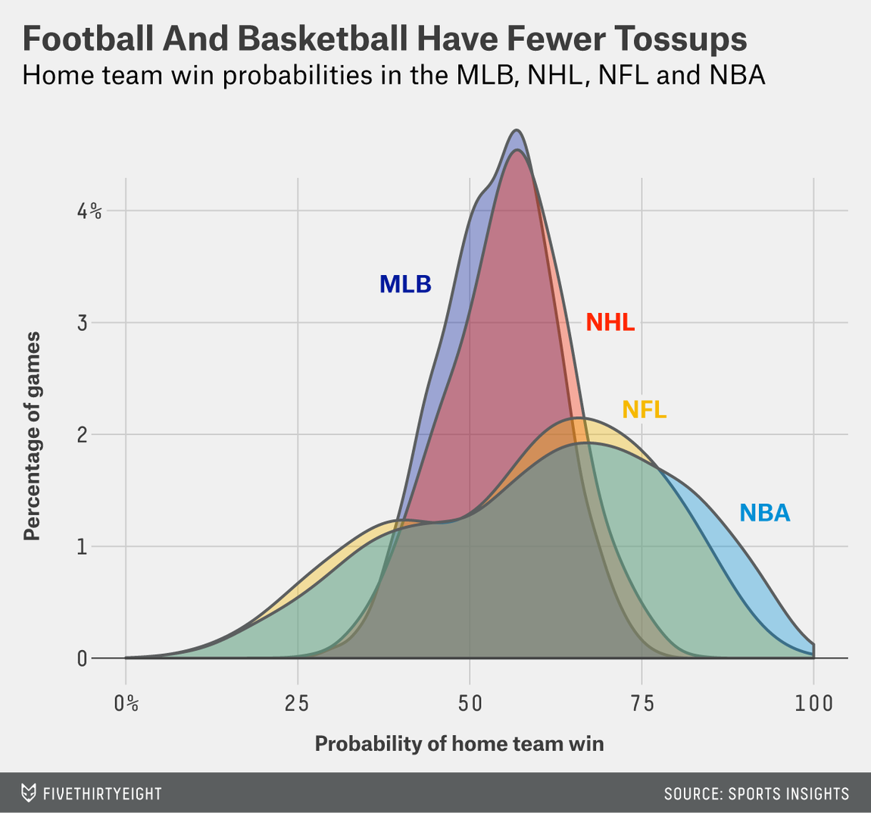
Chance of winning at home

Slide 7
Pie Charts (only for categorical data – use sparingly)

Slide 8
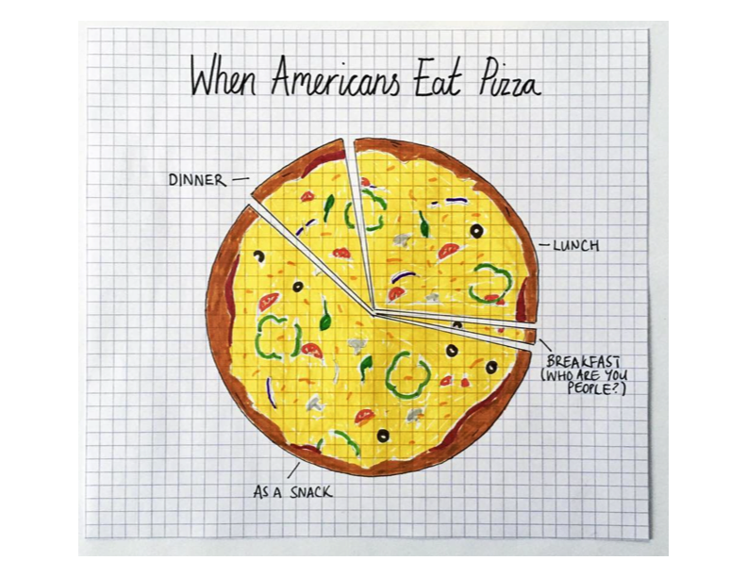

Slide 9
Bar Graphs (Mainly for Categorical Data)

Slide 10
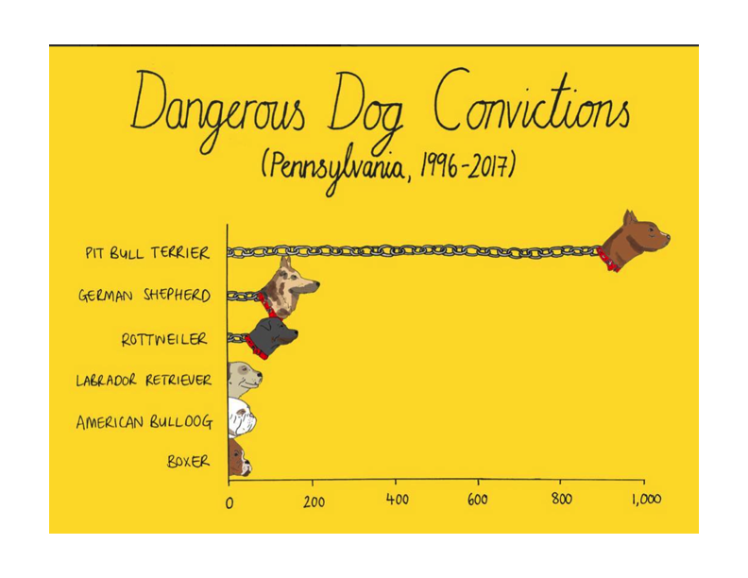

Slide 11
Maps

Slide 12
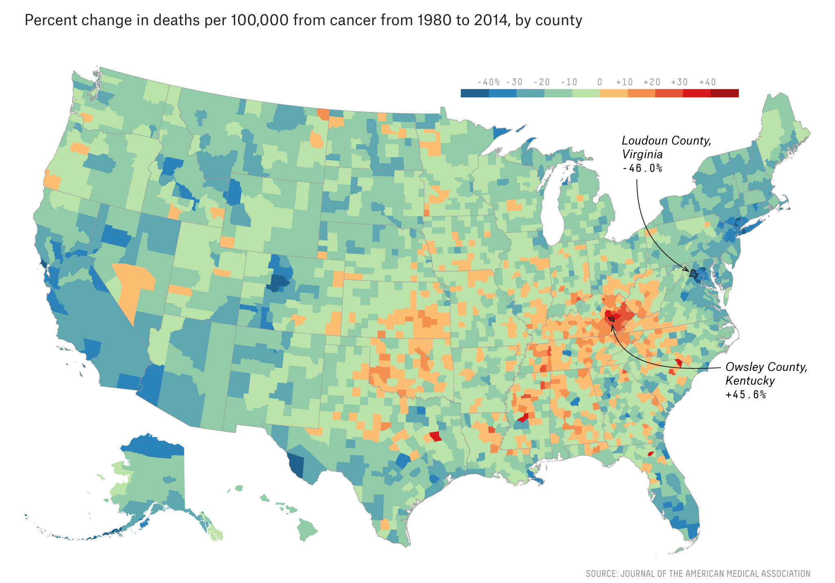

Slide 13
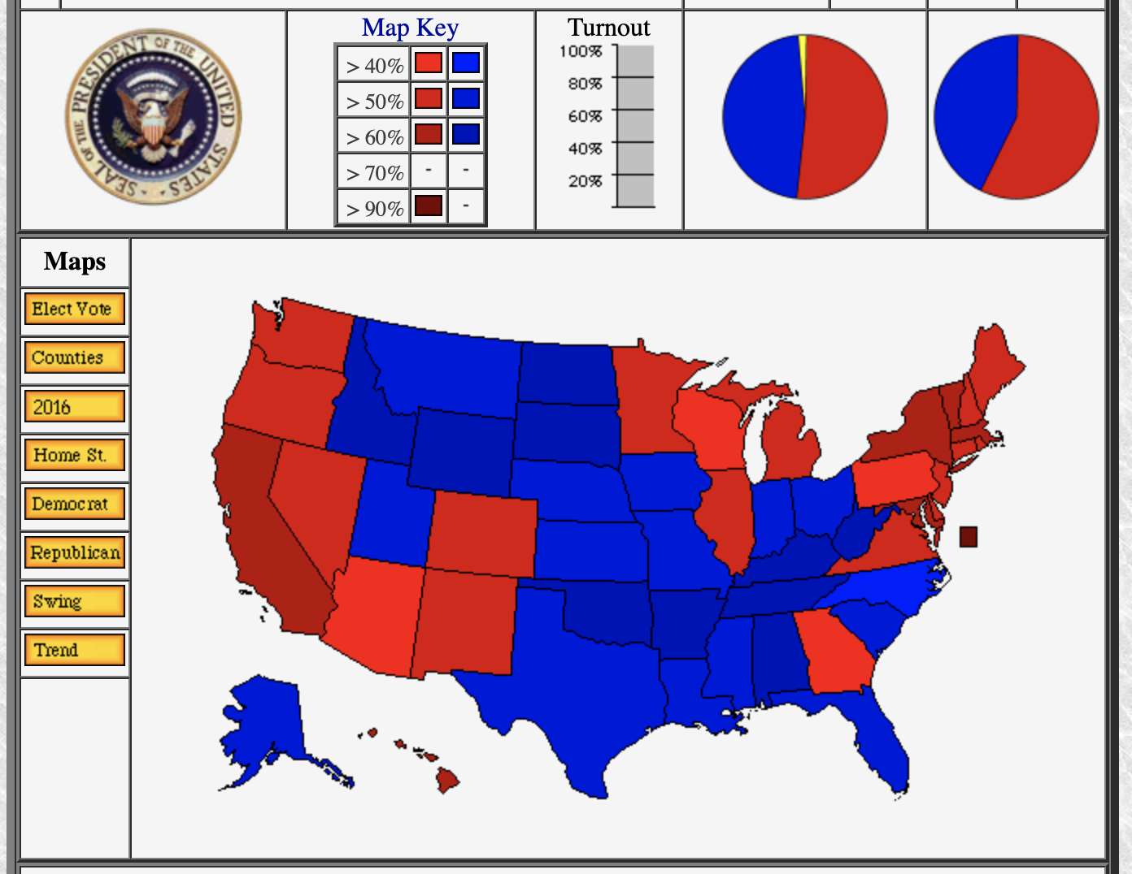
From usaelectionatlas.org

Slide 14
Boxplots

Slide 15
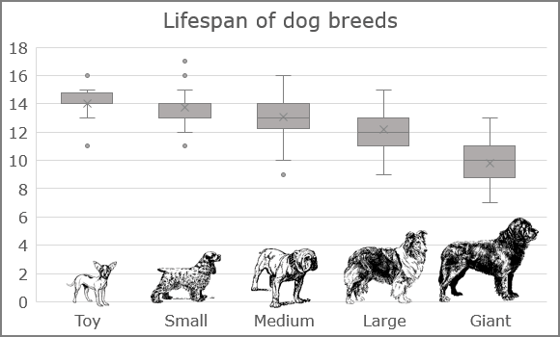

Slide 16
Scatterplots (where neither variable is Time)

Slide 17
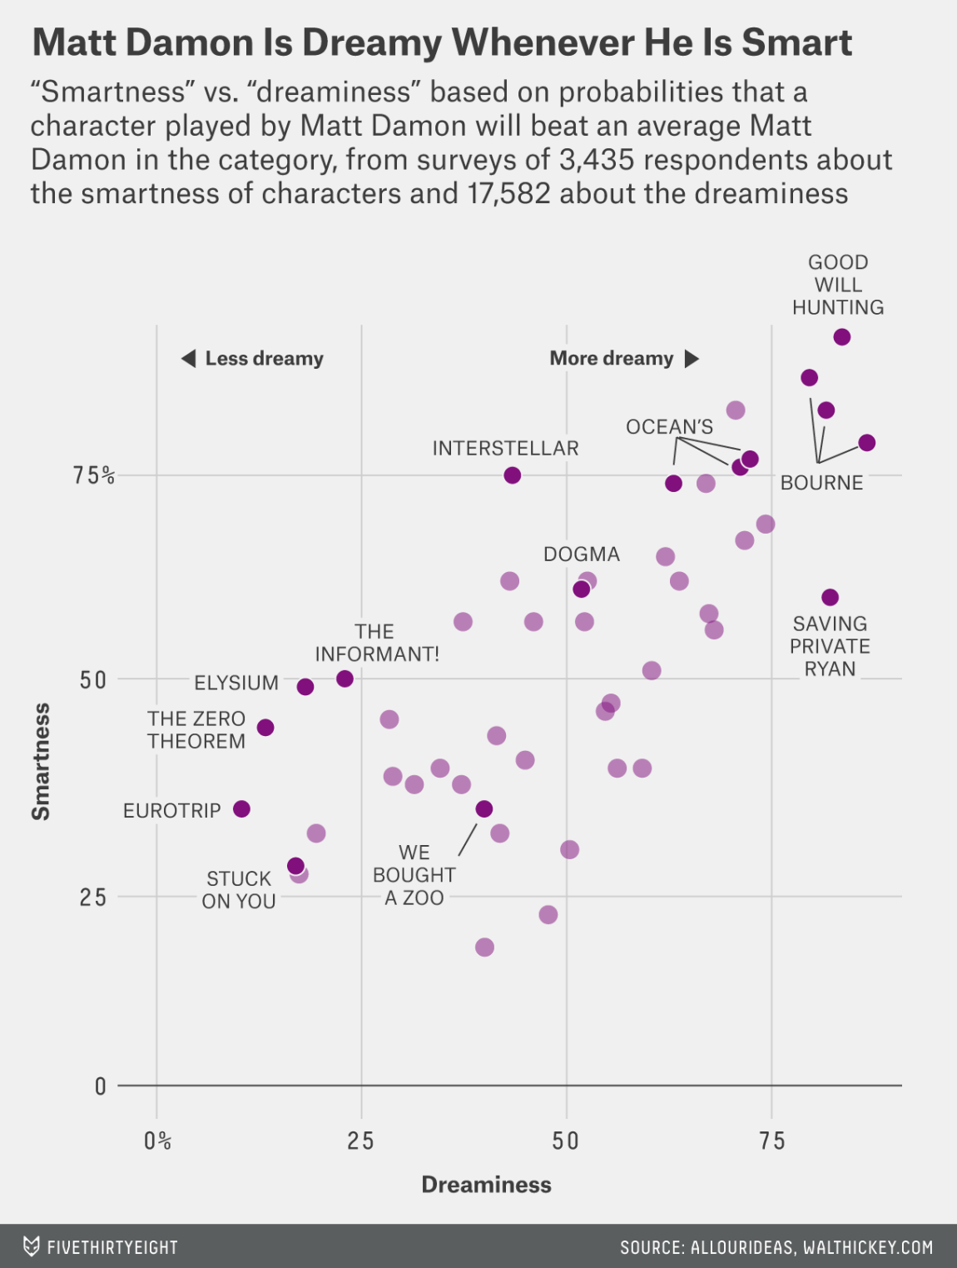
Matt Damon

Slide 18
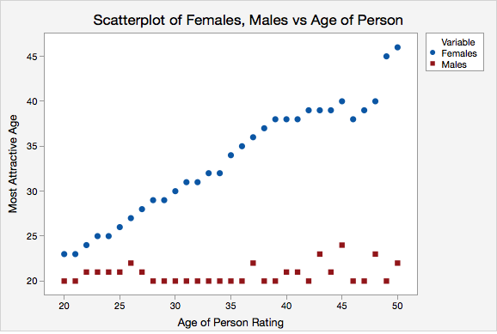
*OK Cupid Data

Slide 19
Time Series Graphs

Slide 20
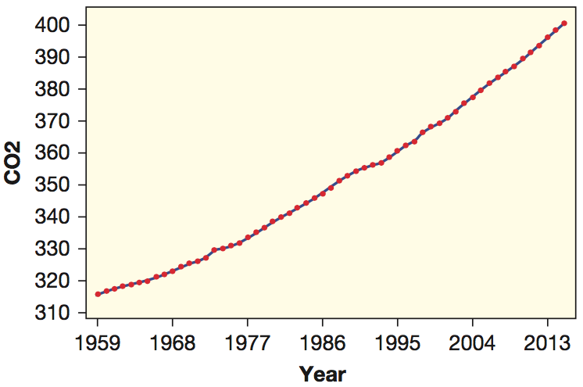
*Data Over Time
Concentration of carbon dioxide (CO2) in the atmosphere in parts per million (ppm) over time:
Data from Dr. Pieter Tans, NOAA/ESRL and Dr. Ralph Keeling, Scripps Institution of Oceanography

Slide 21
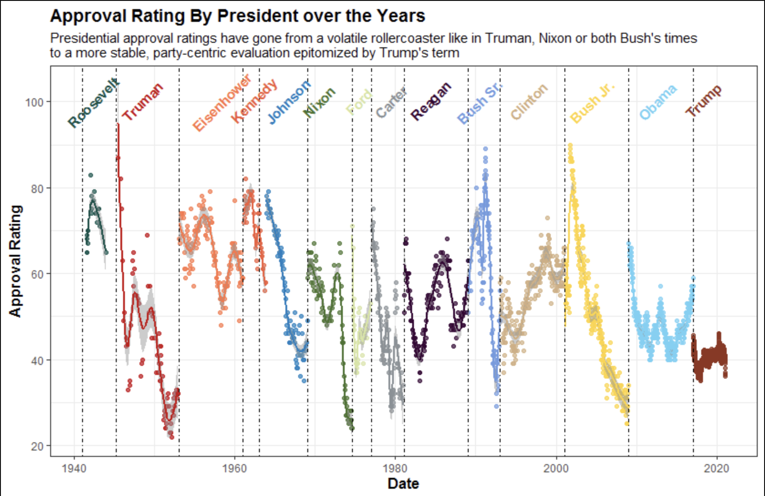

Slide 22
Multivariate…

Slide 23
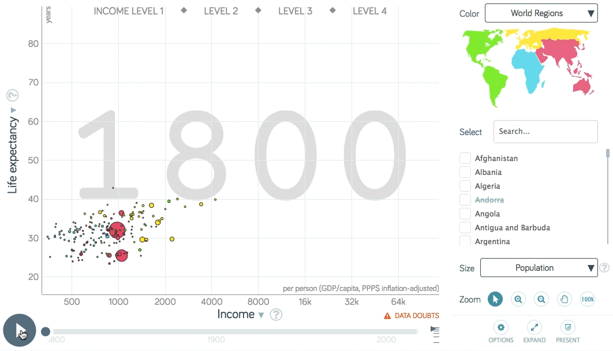
*Gapminder
https://www.gapminder.org/
Hans Rosling’s 200 Countries, 200 Years, 4 Minutes

